Slide 1
COMMUNICATIVE SKILLS (CMS 107)
TOPIC: TYPES OF SENTENCES (STRUCTURE)
BY
ALFRED OKRAH

Slide 2
What is a Sentence?
A group of words which expresses a complete thought.
Completeness of a sentence means the following:
  There should be subject and predicate.
  There should be agreement between the subject and predicate.
  When written, the sentence should begin with a capital letter and end with an end mark such as the full-stop (period), question mark, or exclamation mark.

Slide 3
STRUCTURAL TYPE OF SENTENCES
Simple sentence
Compound sentence
Complex sentence
Compound-complex sentence

Slide 4
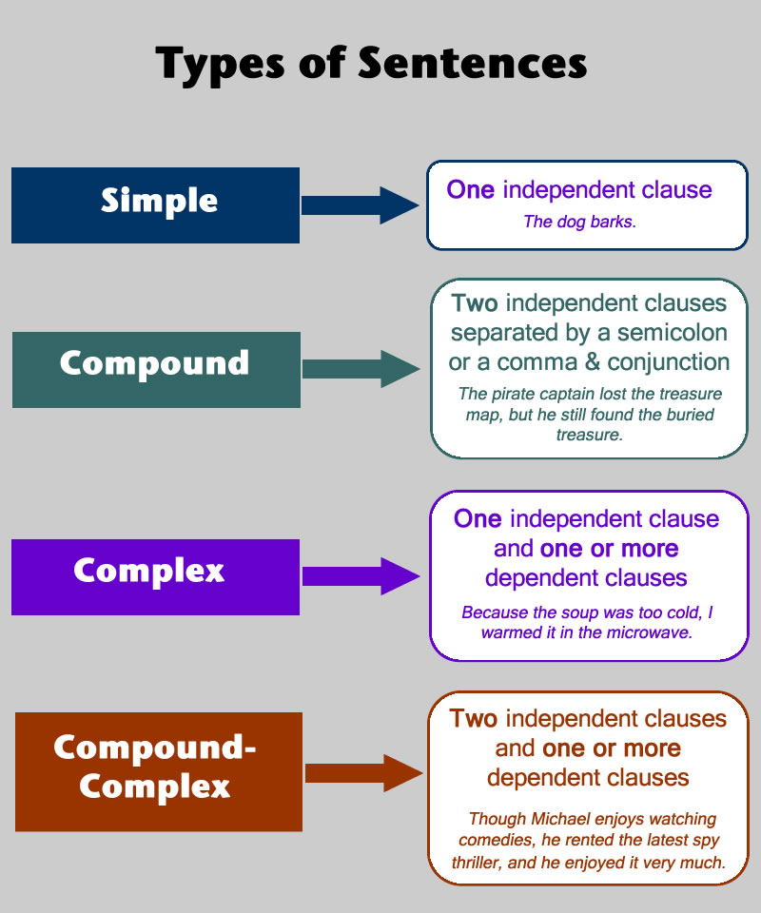
Structural types of sentences

Slide 5
Simple SENTENCES
A simple sentence is the one with one independent clause. It contains only one idea, has a single clause with no dependent clause. It requires a subject and a verb.
  The players arrived.
  Aba danced beautifully.
  Jesus wept.
  Martin is a rich man.
  James throws the ball.
  James looks well.
  James takes his bath.

Slide 6
Compound SENTENCES
COMPOUND SENTENCE. It is a sentence which consists of two independent clauses connected by a coordinating conjunction or when the two independent clauses are separated by a semi-colon.
  Example
  I apologized to her, but she did not forgive me.
  Diana sings and Esi plays the piano.
  Adu ran fast but he missed the train.

Slide 7
COORDINATION
The process of joining two independent sentences into one sentence by using a coordinator is called Coordination. In coordination, the status of the sentences is not reduced when they are combined. In other words, when they are combined, they still remain independent clauses.
Meaning that a compound sentence is formed when two or more simple sentences are joined or coordinated together.
Coordination, therefore, consists of constituents of equal elements.

Slide 8
COORDINATION
In English, we can have up to seven (7) coordinating conjunctions; for, and, nor, but, or, yet, and so. These coordinators are always placed between the clauses they coordinate. (FANBOYS-For, And, Nor, But, Or, Yet and So).
  The player performs well, for he trains regularly.
  We went to the movies, and we ate potatoes.
  He did not study for the exam, nor did he pass.
  Visiting tourist sites can be very fulfilling, but it can be expensive.
NB: Remember to bring a comma before the coordinator.

Slide 9
COORDINATION
My favourite shirt is worn out, but I don’t want to throw it away.
My mother enrolled in a Spanish class, for she wanted to visit Spain.
Jennifer is a good student, so I gave her an A.
Are you coming with me, or are you staying?
She is naturally beautiful, yet she always wears heavy makeup.
She does not love me, nor does she want anybody else to love me.

Slide 10
Trial questions
Combine the following sentences into a single sentence by the process or processes indicated in brackets.
He searched through her closet. He was surprised at finding no incriminating evidence. (Coordination)
The jury heard the case of the rapist. It ordered a new trial. The activists were greatly offended. (Coordination)
I had a terrible day. My son broke out in measles at dawn. I missed my class for the second time. (Coordination)

Slide 11
Subordination
Subordination is the process of joining or combining two or more dependent clauses to one or more independent clause(s) in a sentence structure.
. Examples of subordinators include because, since, as, though, when, if, until, since, as soon as, as if, even if, unless, although, even though, hence, therefore, henceforth, because etc.

Slide 12
THE COMPLEX SENTENCE
A complex sentence is formed when one main (independent) clause, and at least one subordinate (dependent) clause are joined by a subordinating conjunction(Quirk, 1973).
Meaning that a complex sentence consists of one main clause, and one or more subordinate clauses subordinated to it.

Slide 13
complex SENTENCES cont’d
  If it rains, I shall stay at home.
  Although she is beautiful, no one likes her.
  When I came home, Dad was fast asleep.
  Wherever she went, he met her.
  If you go, tell Adjoa to see me.
  Joseph gets a headache when the humidity is high,
  Because Gifty was hungry, she ate the food.
  As soon as I entered the room, she rushed out.

Slide 14
Examples
Although I understand your point, I do not agree with it.
Even though the Headmaster has made many changes in the school system, more needs to be done.
Whenever Gloria travels, she makes friends instantly.
I want you to wake me up when it is time for the class.

Slide 15
Compound-complex SENTENCES
COMPOUND-COMPLEX sentence is a sentence which contains two independent clauses and one subordinate clause.
A compound-complex sentence has at least two independent clauses and at least one dependent clause.
The compound-complex sentence combines elements of compound and complex sentences.
Even though she was tired, Abby knew she had to finish the race so she ran to meet her team.
Although Ransford was late for the lecture, he organised himself within a few minutes and did a fantastic presentation.

Slide 16
EXAMPLES OF COMPOUND-COMPLEX SENTENCES
I bought coca cola, and I drank it at once because I was very thirsty).
Mary doesn’t like cartoons and she doesn’t watch them because she feels they are meant for children.
Zakiyyat could not attend her friend’s birthday, so she sent her a parcel when she finally remembered.

Slide 17
TRIAL QUESTIONS
The University central committee reaches a decision today. The Students’ Representative Council will not support such a confrontational attitude. (Coordination)
I just graded her latest paper. She is capable of good work. She needs to be motivated. (Coordination)
The students felt so relieved. The rains finally stopped. (Subordination)
I have visited you four times. You have visited me once. (Subordination)
Several graduates do not know what to do after graduating. The Universities need guidance experts to help them out. (Subordination).
There are too many hawkers on this campus. They leave the campus littered with garbage. They pose a health hazard. (Coordination and Subordination)
The messenger apologized for his sloppiness again. The supervisors paid no attention. They remembered the last time he rendered an apology for sloppiness. (Coordination and Subordination)

Slide 18


Slide 19


